Slide 1
GPT NLP Lab Assistant Group 3
The Autonomous University Robot Assistant (AURA) Project - Robotics/UI Interface Subsystem
David Haybarger

Slide 2
Functions & Design Constraints
Robotic design based on TARS from the movie Interstellar that is capable of fluid independent movement via bluetooth communication.
Must be able to walk and pivot
Ample room for integration with future subsystems while maintaining our plans of having a desktop sized robot for laboratory environment integration.
Operate at the minimum voltage rating (4V) for increased headroom from power subsystem.
Must interface/communicate with Jetson Orin Nano. Robotic subsystem should be completely isolated except for temporary hardwired power system.
Custom microcontroller capable of wireless communication, I2C channels, servo power and 3.3V logic inputs.

Slide 3
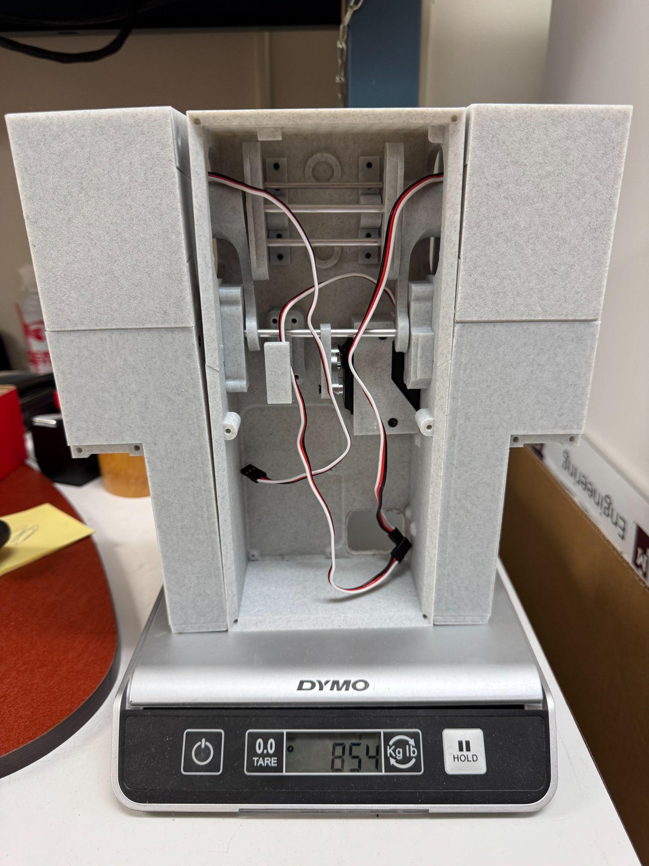
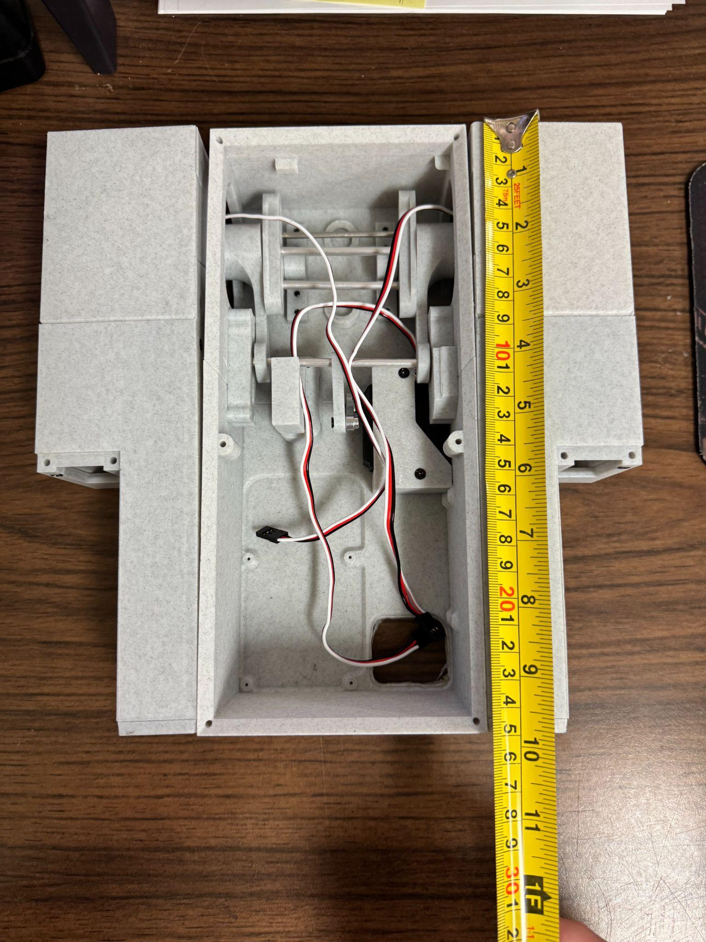
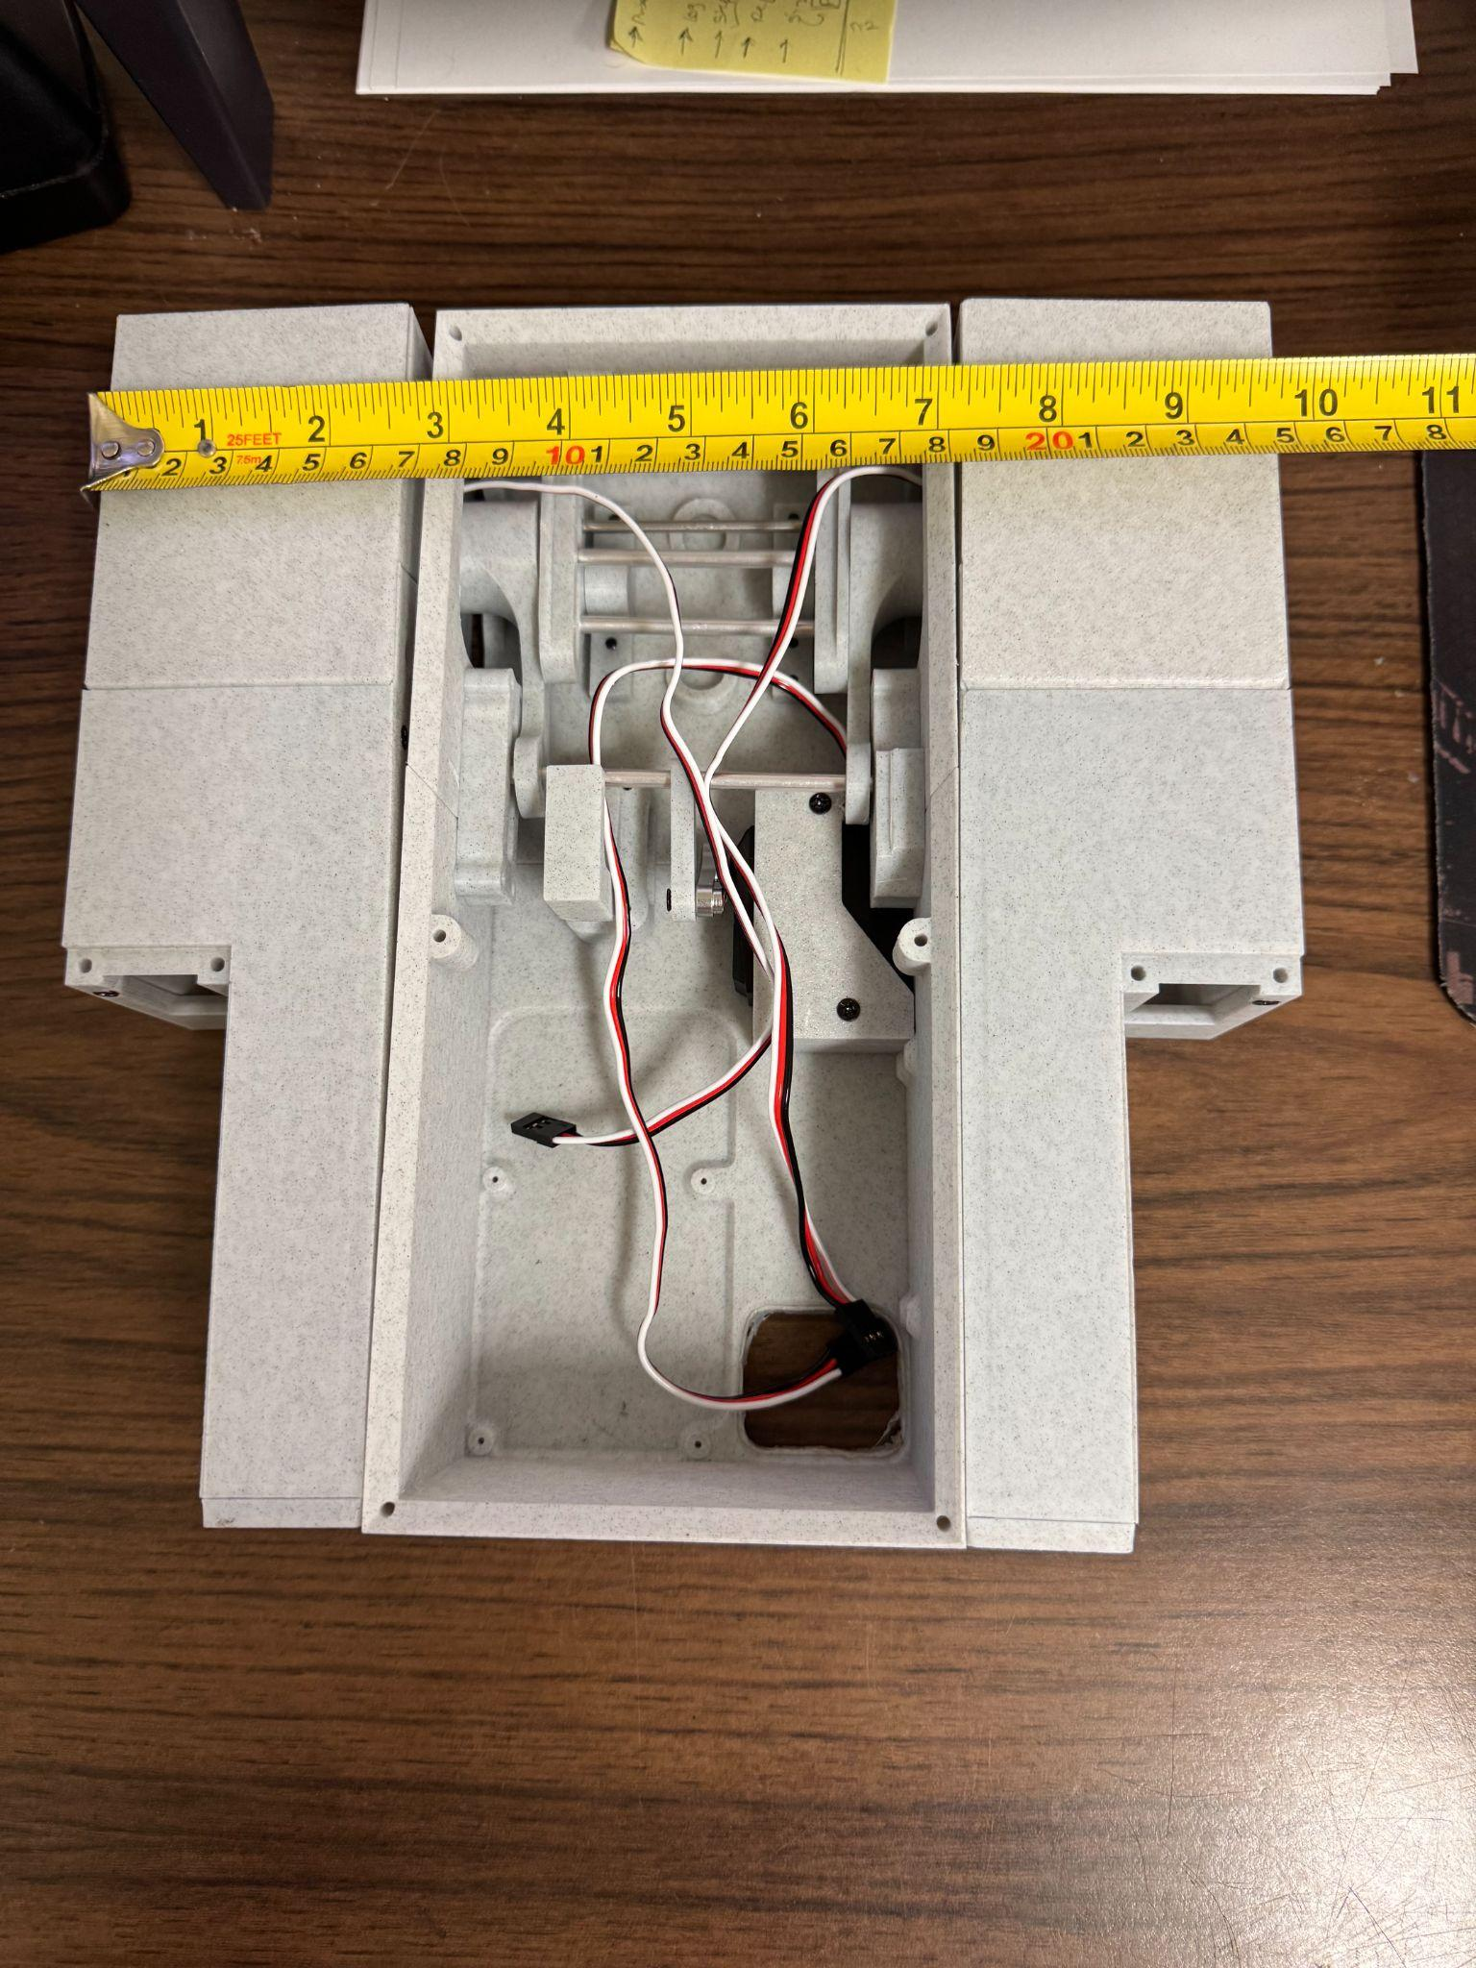
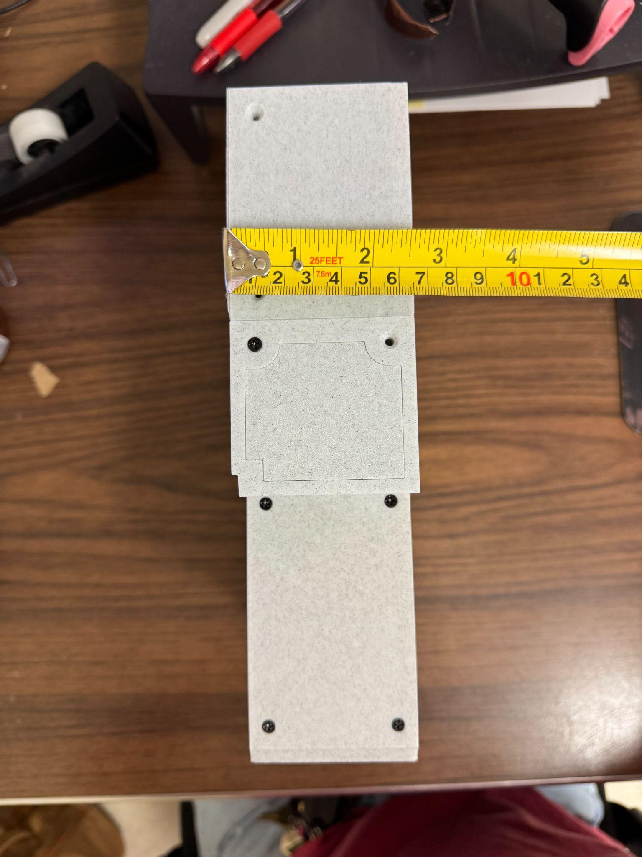
Measurements/Dimensions
Weight Length Width Height
854g 10” 9.75” 2.75”

Slide 4
Validation Plan Verification (Part 1)
Paragraph # | Test Name | Success Criteria | Methodology | Status
3.2.2.1 | Robotic System Mass Validation | Total robotic subsystem mass ≤ 7kg | Weigh fully assembled robotic subsystem; verify ≤ 7kg using calibrated scale. | Tested. Robotic subsystem weighs < 1kg.
3.2.2.2 | Dimensional Compliance Validation | Unit dimensions ≤ 12 in (L) x 8 in (W) x 36 in (H) | Measure assembled structure; confirm compliance with dimensional compliance. | Tested. Robotic subsystem within dimensional compliance.
3.2.3.1.1 | Servo Power Validation | Servo motors operate reliably at 5V ± 5% and < 1 A draw per servo under load. | Power subsystem test: measure voltage/current while actuating servos through ESP32 PWM. | Tested. Servos operate robotic subsystem within success criteria range. Robotic subsystem works at servo minimum voltage (4V).
5.1.1 | Power Distribution Validation | Motor control PCB capable of varying servo voltage (4-6V) and 3.3V logic. | Simultaneous testing of servo actuation and operational logic from one motor control PCB. | Tested. The motor control PCB is operational with various voltage inputs through separate channels.

Slide 5
Validation Plan Verification (Part 2)
Paragraph # | Test Name | Success Criteria | Methodology | Status
6.4 | UART Communication Validation | UART link between ESP32 and Jetson Orin Nano | Fully independent programming of ESP32 using the Jetson Orin Nano and Arduino IDE. | Tested. Robotics subsystem code can be edited via the Jetson for easy on site behavioral modifications.
3.2.4.1 | Emergency Stop | Servo power disables within 0.5s after E-Stop is pressed. | During movement execution the motors should stop after pressing E-Stop. | Tested. Servos successfully stop after pressing E-Stop button.
3.2.4.1.2 | Fault Recovery Validation | System recovers with ESP32 reset without Jetson reboot. | Simulate UART fault. Verify system recovers without restarting the Jetson. | Tested. Jetson displays ESP32 fault and can be recovered without restarting the Jetson.

Slide 6
Validation Plan Verification (Part 3)
Paragraph # | Test Name | Success Criteria | Methodology | Status
3.1.2 | Servo Performance Validation | Servos achieve required motion for fully maneuverable robotics system. AURA should be capable of ‘walking’ and ‘pivoting’. | Successful demonstration of working subsystem with acceptable misbehaviors attributed to later integration with other subsystems. | Tested. Robotic system is functional with minor design flaws. Improvements are needed from 3D printed mechanical components. Stability issues from weight distribution due to lack of project subsystem integration

